Slide 1

SENIOR PROJECT
AI project with Multithreading

Slide 2


AGENDA
Introduction
Project Idea
Motivation
Build Target
What’s Different?
Project Features
Target Audience
Prototype

Slide 3
INTRODUCTION
Minjang Jin, the Game programming student in LaSalle college
South Korea
No career, started programming A-Z in the college
Favorite things: Drawing and playing Real-time strategy games
C++, C#, and Python
My life in Canada for 3 years = The biggest adventure

Slide 4
PROJECT IDEA
Main idea: Multithreading utilization
Usage of thread: How influence would the implementation of multithreading be given?
What part will I utilize thread for?
Third-person perspective to observe AI’s behavior
Unity engine, and C# language
Direction: Implementation of steering, pathfinding, and stated machine with the utilization of multithreading

Slide 5
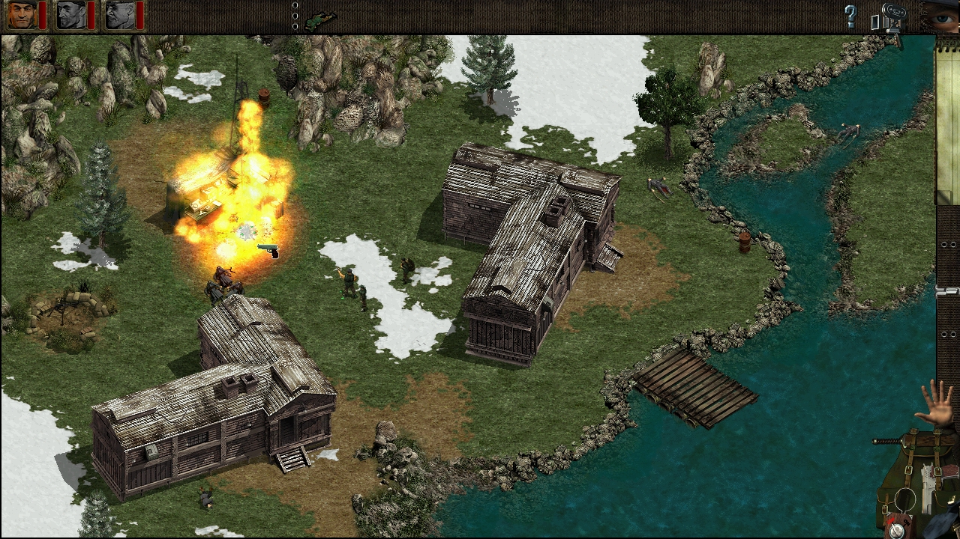
MOTIVATION
Your motivations to build this project
Study multithreading
Senior research – Analyze about Multithreading
Commandos 1

Slide 6
BUILD TARGET
Build Details
Platform: | PC
O.S: | Windows
Camera: | Third
Genre: | Real-Time Strategy

Slide 7
WHAT’S DIFFERENT?
Differences
Offering an experience of how the Multithreading benefits show
Testing proper AI
Optimize other project that need AI machine
Guiding for programming beginners

Slide 8
PROJECT FEATURES
Features
State machine
Any behaviour
Steering machine
Seek, Feel, Pursuit, Evade..
Pathfinding
DFS, Astar
Testing detail
Edit
Status bar for inspecting a performance
Record

Slide 9
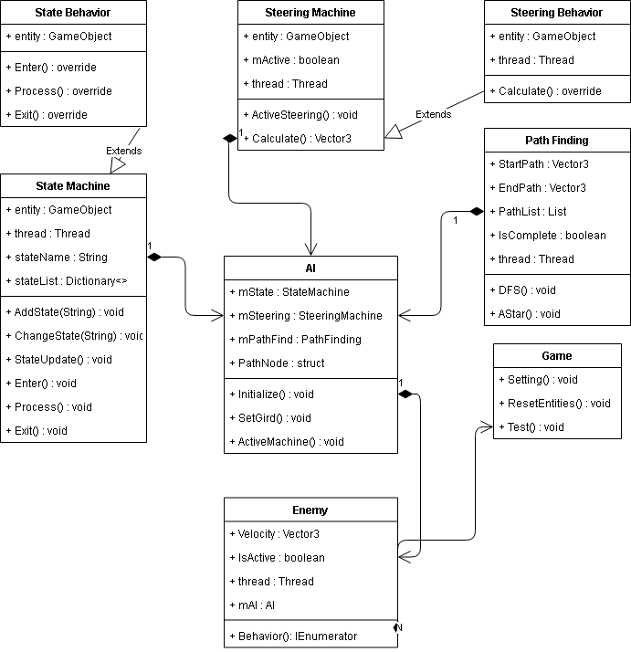
PROJECT FEATURES

Slide 10
TARGET AUDIENCE
What is your target audience?
Whoever audience is, but focus on the programmer who has curiosity of multi-threading.

Slide 11
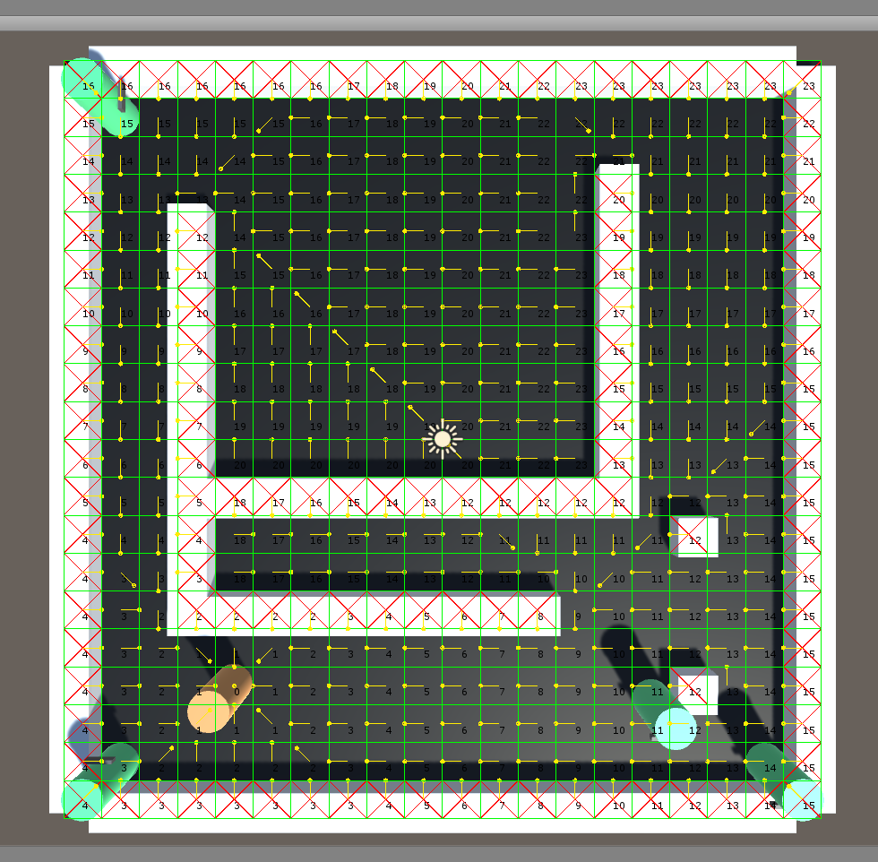
PROTOTYPE

Slide 12

THANK YOU
Don’t ask girlfriend

